Slide 1
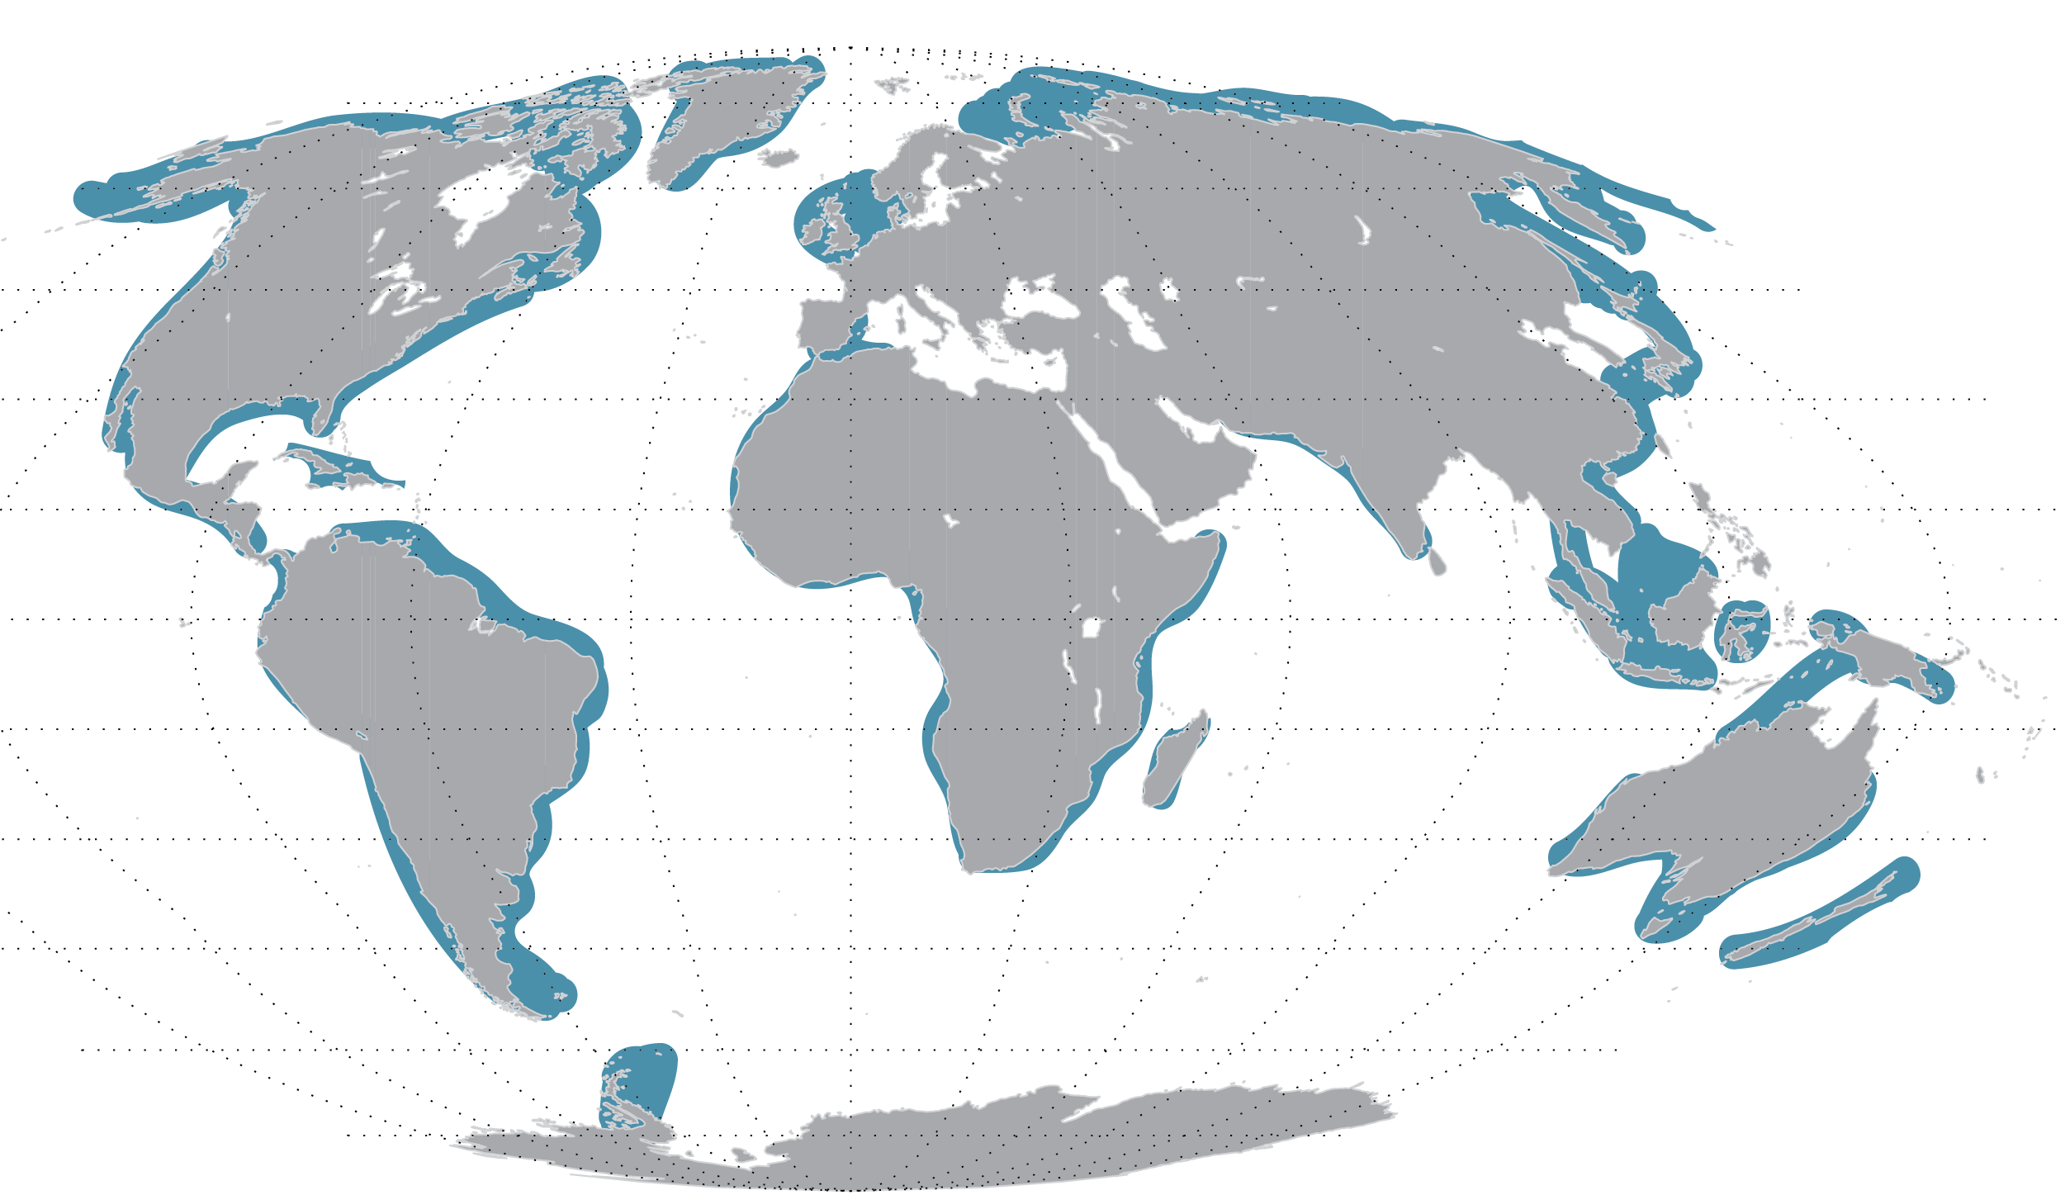
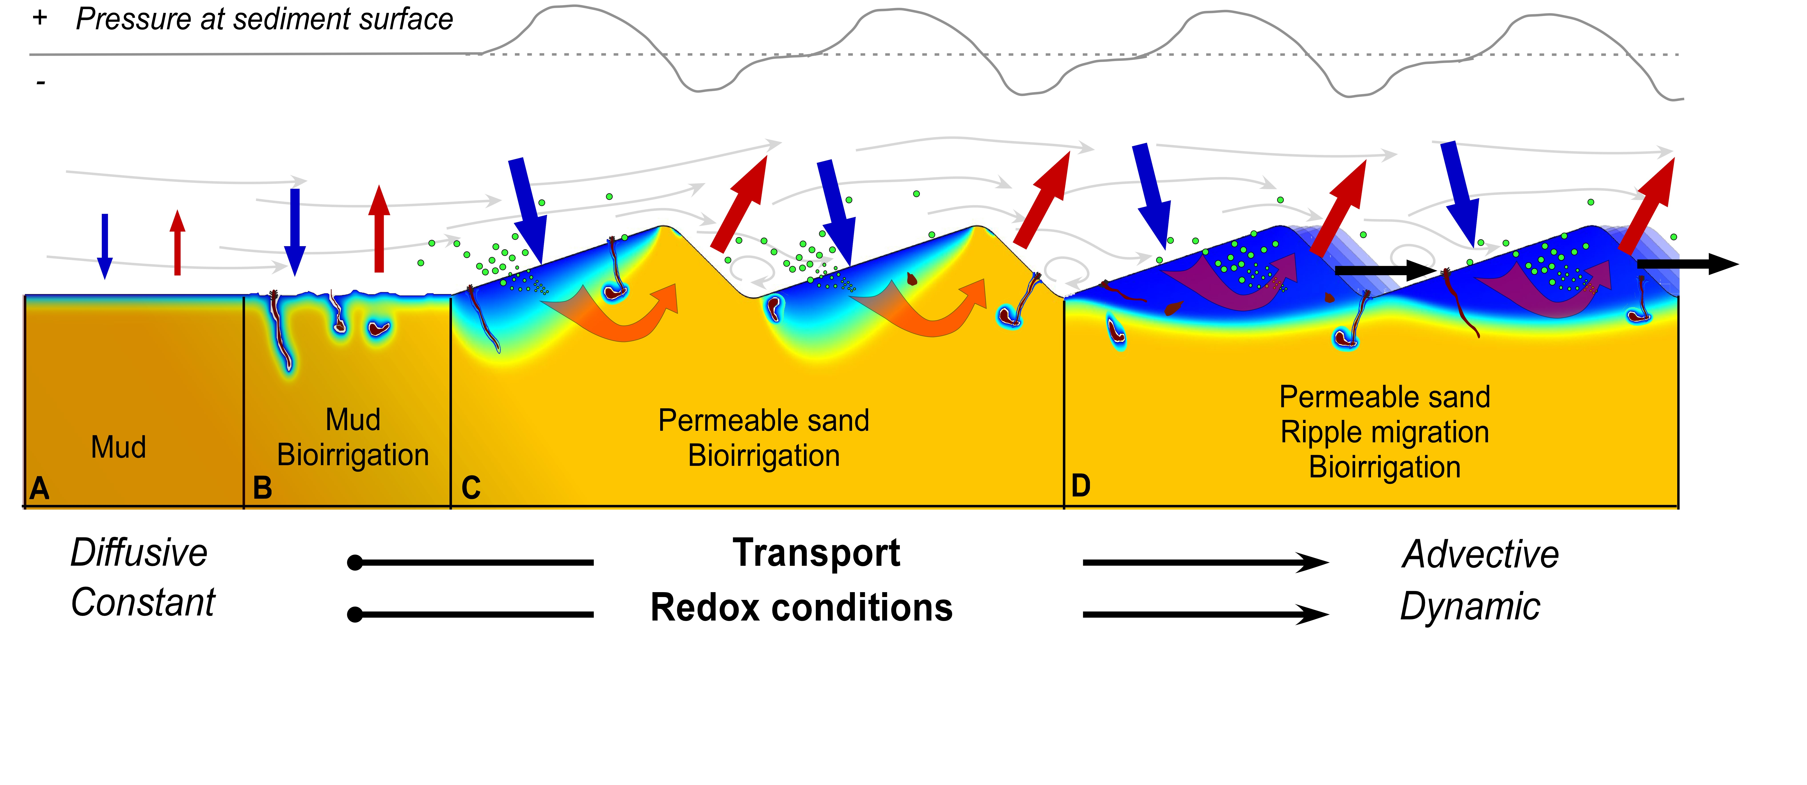
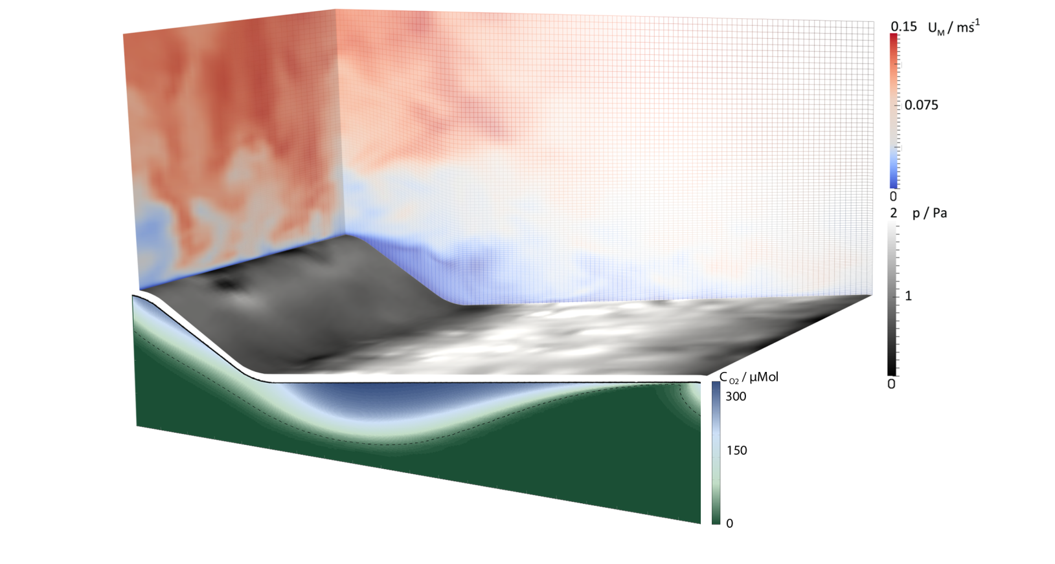
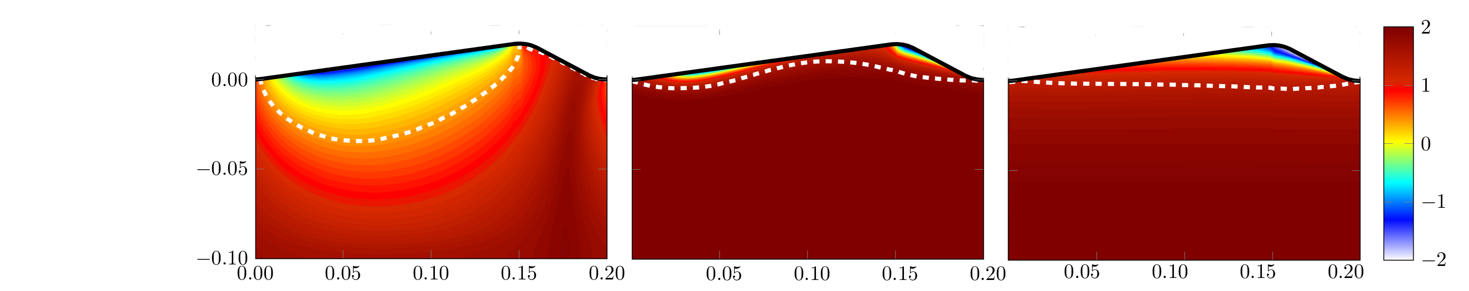
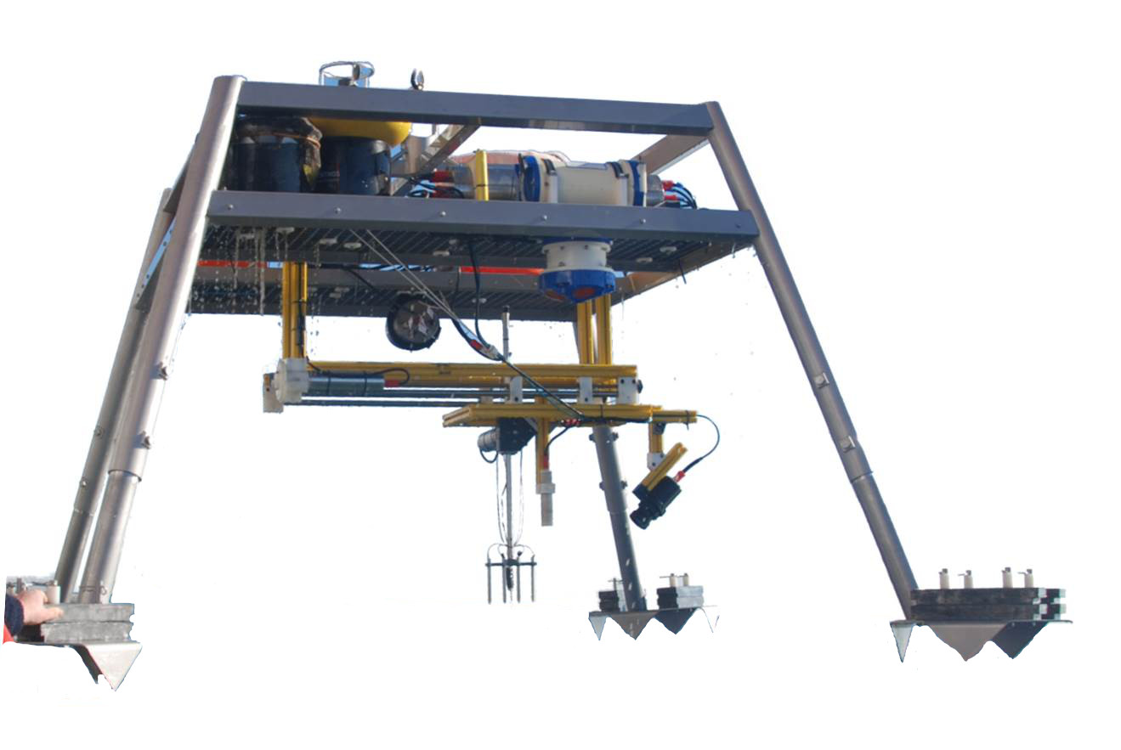
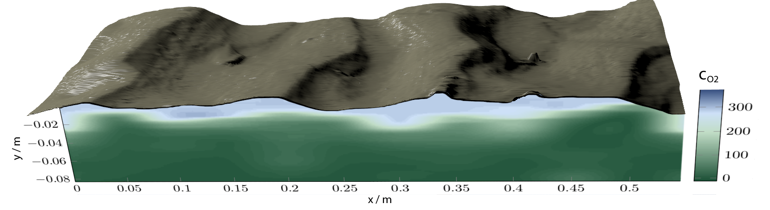
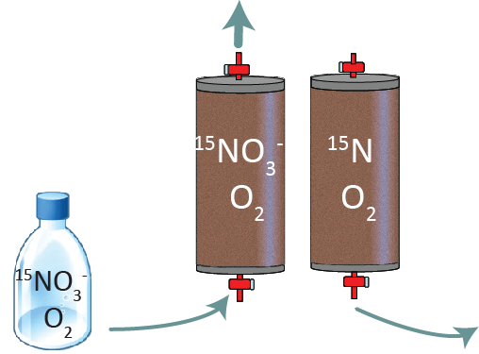
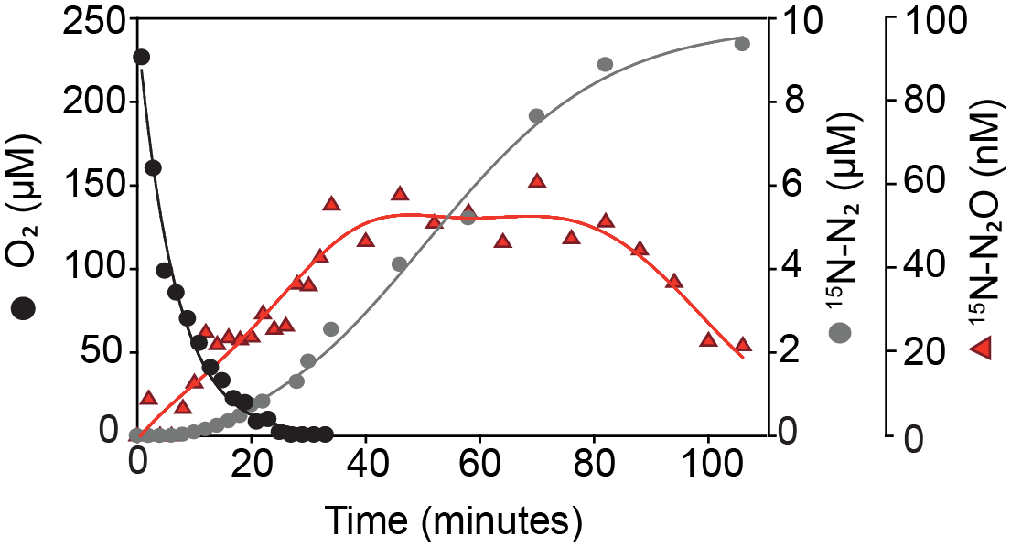
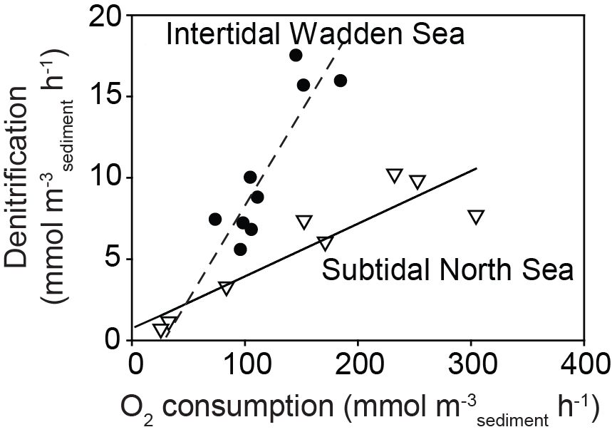
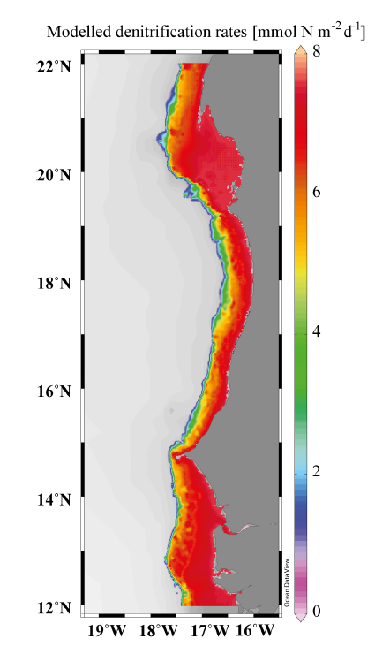
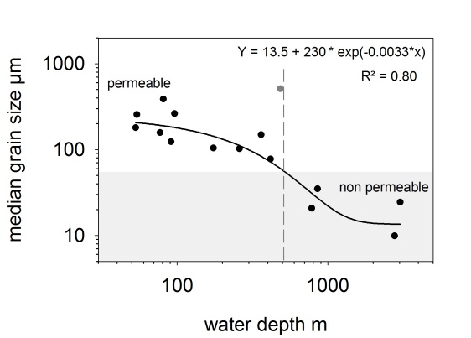
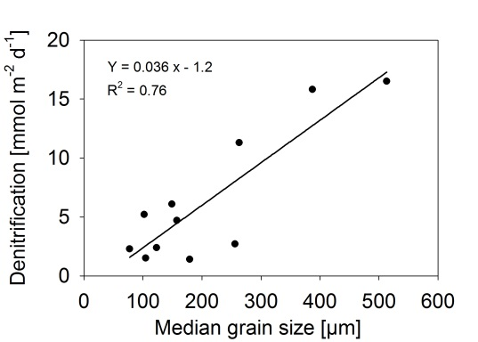
Biogeochemistry and transport dynamics in permeable sediments Soeren Ahmerkamp, Hannah Marchant, Sarah Sokoll, Dirk de Beer, Marcel Kuypers and Moritz Holtappels Max Planck Institute for Marine Microbiology
Department of Biogeochemistry
INTRODUCTION
Up to 70% of the continental shelves are covered by sandy, permeable sediments (Fig. 1). In eutrophied coastal waters, the sandy sea bed provides an effective filter system removing significant amounts of anthropogenic nitrogen input. Current research investigates the dynamic advection of porewater in sands (Fig. 2) and its impact on benthic O₂ uptake and N-turnover with specific focus on:
Nutrients
N₂
C_{org}
O₂
NO₃
Regulation of dynamic redox conditions by porewater and sediment transport
Microbial adaptations and turnover rates under dynamic redox conditions
Approaches to extrapolate rates to regional scales
Fig. 1: The Global distribution of sandy sediments
Fig. 2: The interaction between bottom water flow and seabed topography induces dynamic porewater flow
SEDIMENT AND POREWATER TRANSPORT
Direction of current and ripple migration
Sediment erosion
Porewater release
Sediment deposition
Porewater trapping
Large Eddy Simulation
MODELING
The seabed topography is seldom in steady state. The implementation of ripple migration into multiphysical models of porewater flow and reaction rates cause a significant change in O₂ distribution compared to fixed topography models (Fig. 3).
cm
0
3
6
100
10
1
0.1
0.01
ripple migration
0 cm/h
oxicline
ripple migration
3 cm/h
ripple migration
10 cm/h
Porewater age [hours]
Migration
Wall Shear + Pressure
O₂ Flux: 34 mmol/m²/d
O₂ Flux: 13 mmol/m²/d
O₂ Flux: 22 mmol/m²/d
0 10 20 cm
Reactions + Darcy
Fig. 3: For a fixed topography (left side), O₂ transport depends only on pressure driven porewater flow. The O₂ gradients are highly 2-dimensional. At increasing ripple migration, O₂ uptake from porewater trapping dominates and eventually the ripple is fully flushed (right side). The O₂ gradients become quasi 1-dimensional.
FIELD STUDIES
Combining topography scans with O₂ measurements in underlying porewaters reveals deep O₂ penetration and a correlation between the oxicline and sediment topography (Fig. 4). Areal rates can be estimated by integrating O₂ consumption rates (see below) over the oxic layer.
Direction of current and ripple migration
O₂ µM
O₂ Flux: ~30 mmol/m²/d
Fig. 4: The O₂ distribution beneath a rippled topography of subtidal North Sea sediment. Ripples are fully oxic, and the oxicline correlates with the topography. Current velocity : ~25 cm/s, ripple migration: ~2 cm/h.
O₂ AND NO₃⁻ CONSUMPTION RATES
1. Flushing 2. Incubation
O₂ consumption and N-loss rates were determined in percolated cores. Denitrification was active under oxic and anoxic conditions (Fig. 5) thus enlarging the layer where N-loss occurs. Nitrate reduction was associated with the accumulation of N₂O, leading to significant N₂O emissions from sandy sediments.
Fig. 5: The dynamics of N₂O and N₂ production over time as oxygen is consumed in a percolated sediment core
Fig. 6: Oxygen consumption and denitrification rates measured over different seasons (Wadden Sea) and for different permeabilities (North Sea).
O₂ consumption and N-loss rates correlate and depend on season and sediment grain size (Fig. 6). Empirical relations between water depth, grain size and denitrification rate were applied to extrapolate results of 11 stations to the Mauritanian shelf area (Fig. 7).
OUTLOOK
Modelling:
Use measured topography and current velocity as boundary conditions
Implementing N-cycling by applying measured rates and kinetics
Rates: study the effect of dynamic redox conditions on
Nitrification
Iron and Manganese cycling
Physical drivers: Investigating the relation between
Grain size and filtration efficiency of particulate organic matter
Grain surface area and maximum rates
Denitrification [mmol N / m² / d]
Fig. 7: The upwelling region off North-West Africa provides high NO₃⁻ and C_{org} concentrations above sandy shelf sediments. Extrapolated N-loss over an area of 84,000 km² amounts to 2.8 megatons N per year.
ACKNOWLEDGEMENTS
Research is conducted in close collaboration with the Sediment Dynamics Group in MARUM.
The projects are funded by the Max Planck Society and Deutsche Forschungsgemeinschaft (through the Marum Center for Marine Environmental Sciences)

